Slide 1
Image Inpainting
“Bridging the gap between absence and presence”

Slide 2
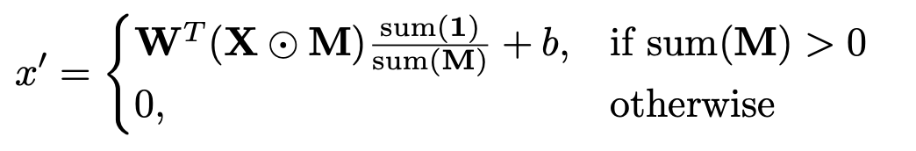
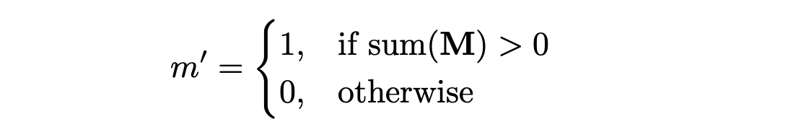
Partial Convolution

Slide 3
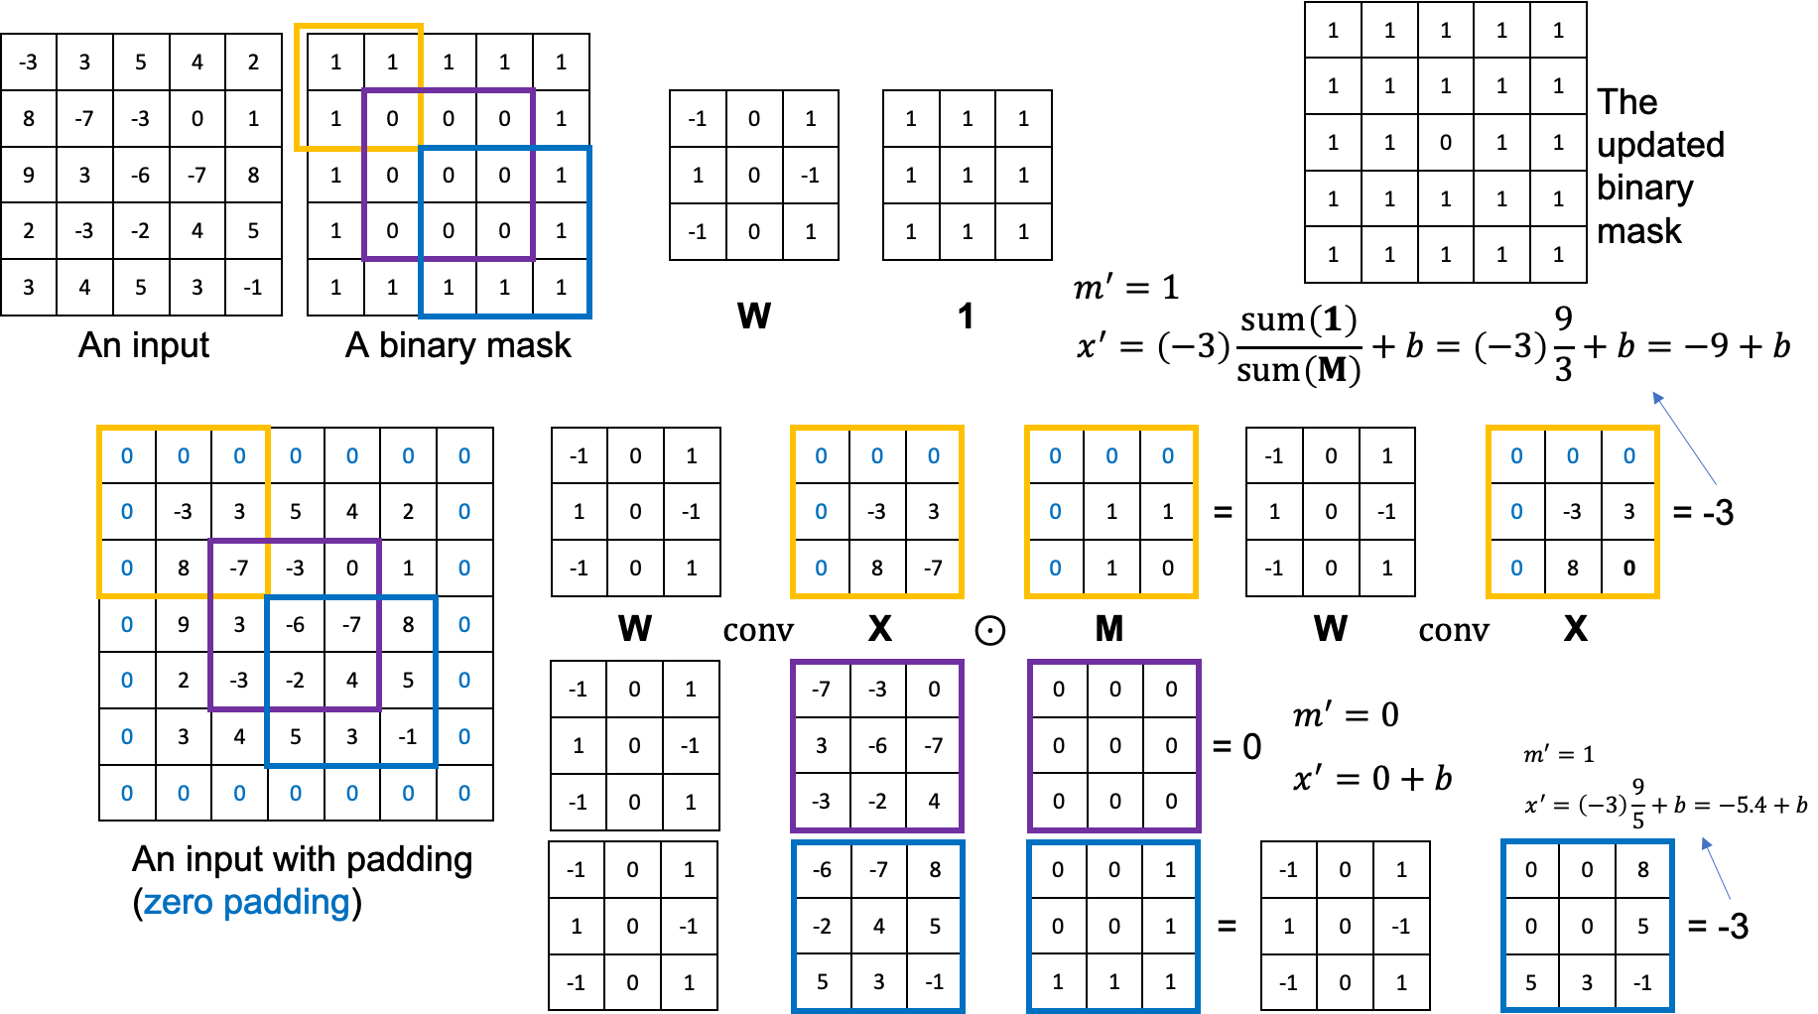
Partial Convolution

Slide 4
Dataset and Preprocessing
We used the Aerial Landscape Dataset from Kaggle, containing a large collection of 256x256 images from various geographical scenarios.
We generated random irregular masks for each image using a custom script.
Unlike previous works that typically use regular rectangular masks, we generated masks with diverse shapes and sizes.
This approach ensures that the model learns to handle a wide variety of real-world occlusion scenarios.
Irregular masks more closely simulate natural corruptions or obstructions in images compared to simple rectangular blocks.
Each image-mask pair was used as input for model training
The model was trained on the masked images along with their respective masks.

Slide 5
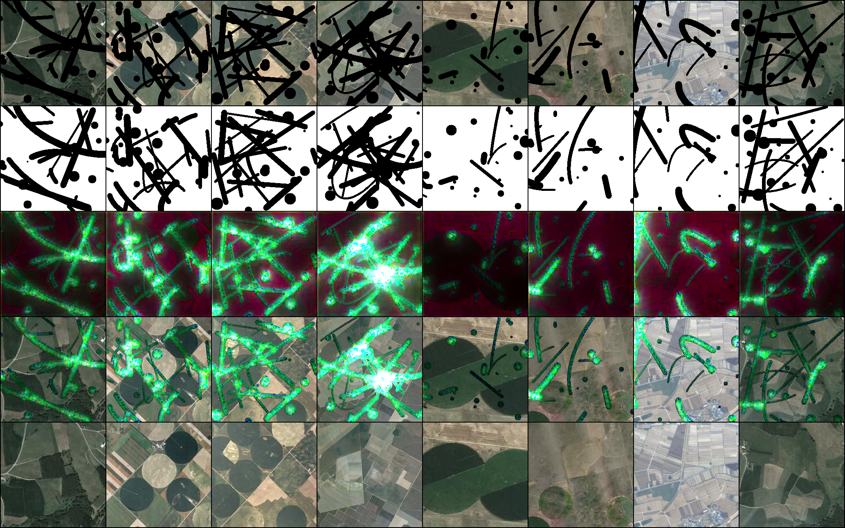
Progress during Training
Predictions after 0 steps

Slide 6
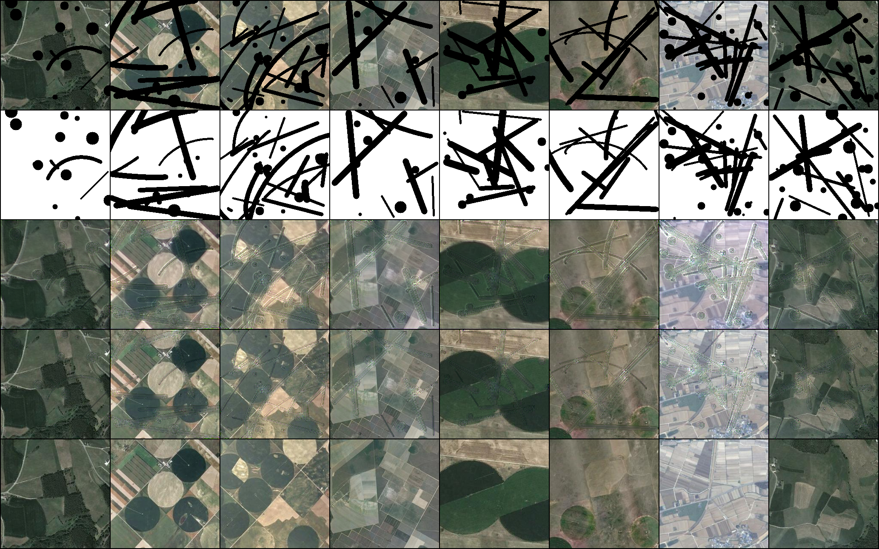
Progress during Training
Predictions after 399 steps

Slide 7
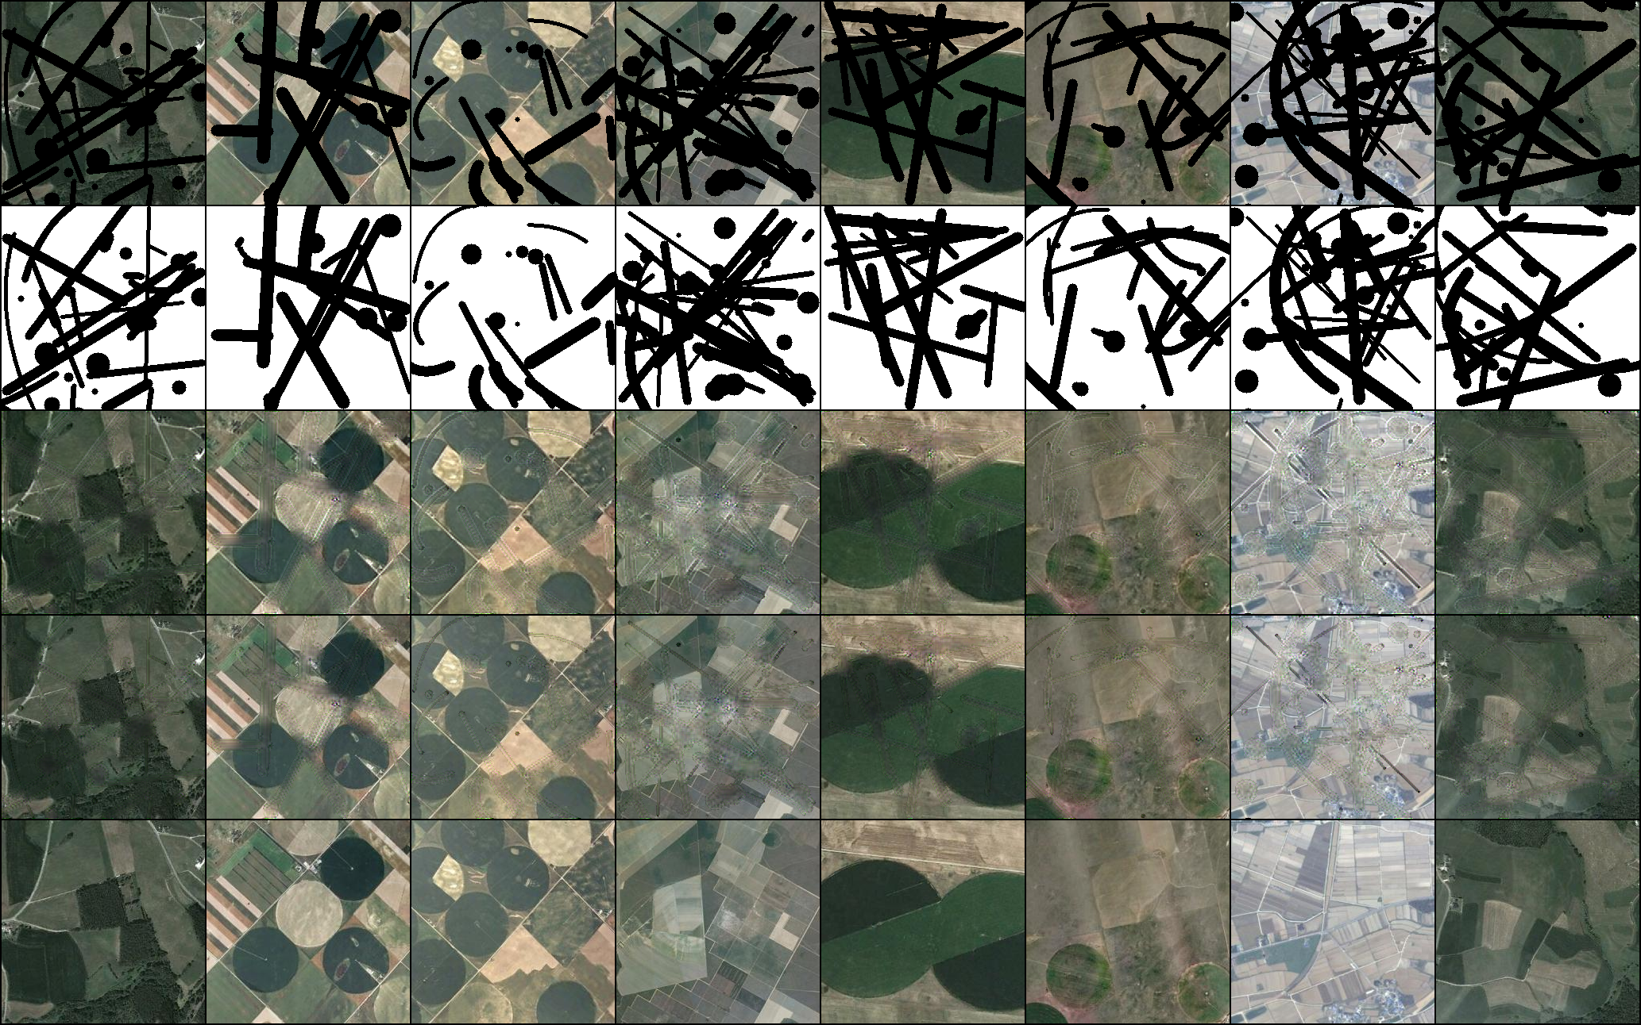
Progress during Training
Predictions after 799 steps

Slide 8
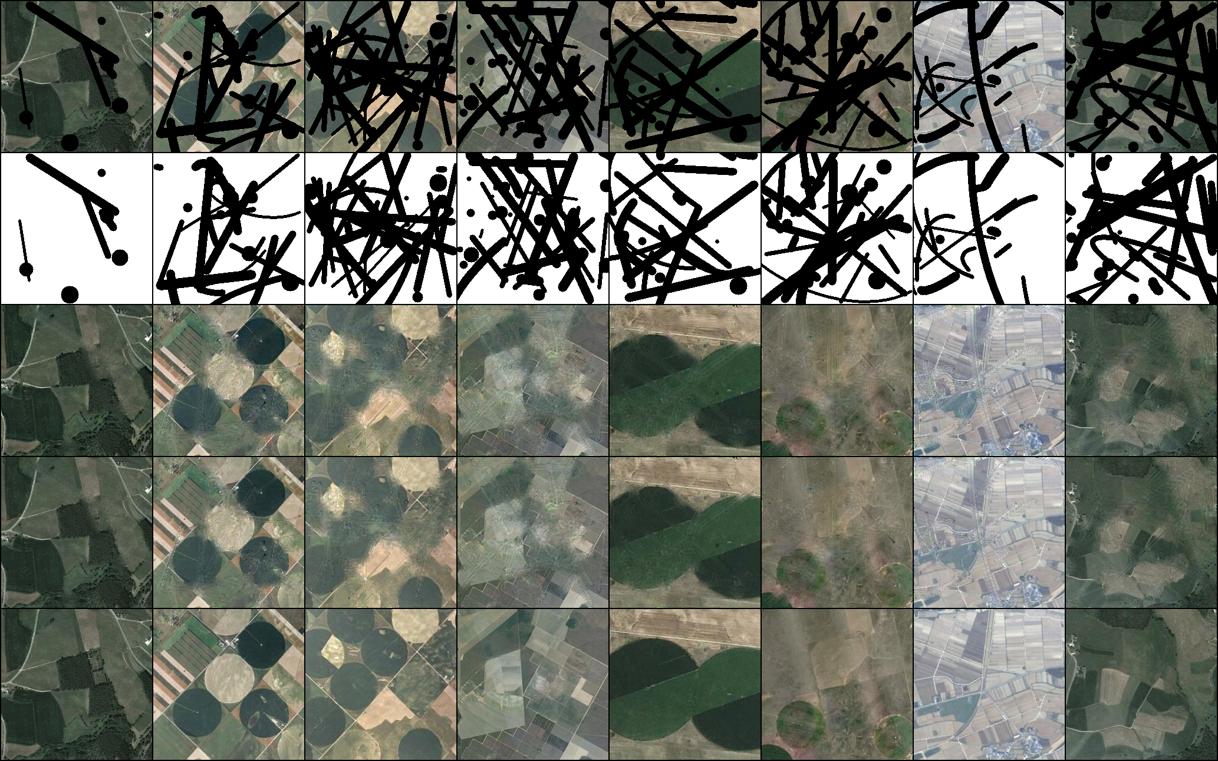
Progress during Training
Predictions after 1253 steps

Slide 9
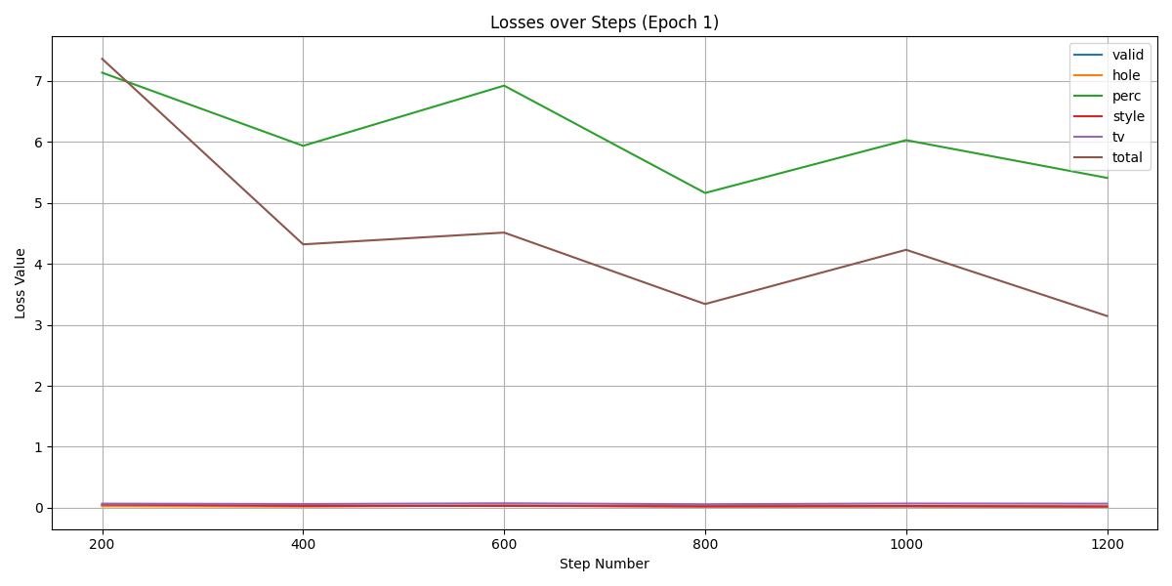
Loss History Graph
Loss curve during training showing convergence over time.

Slide 10
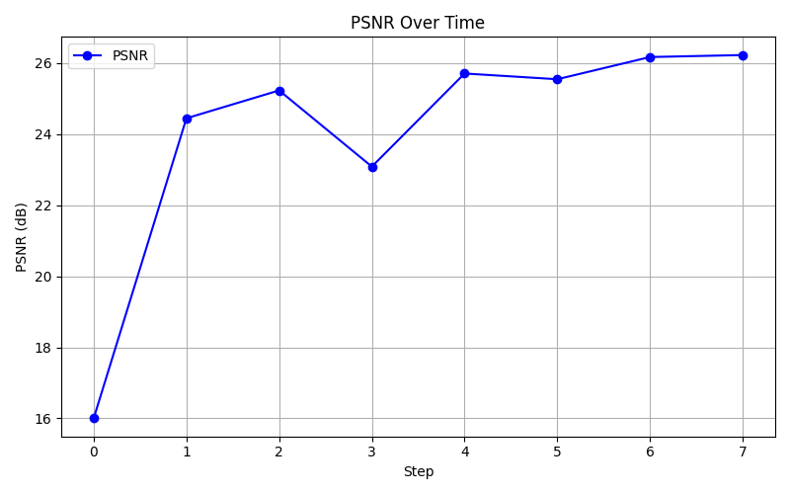
Evaluation Metrics

Slide 11
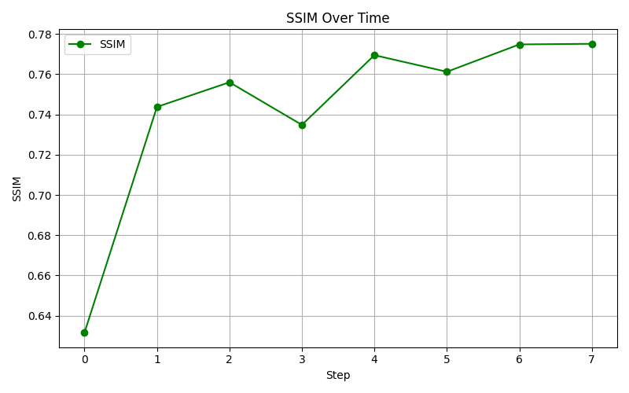
Evaluation Metrics

Slide 12
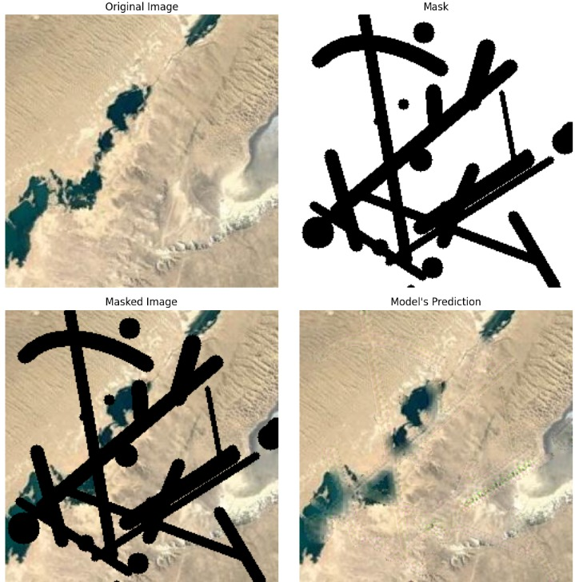
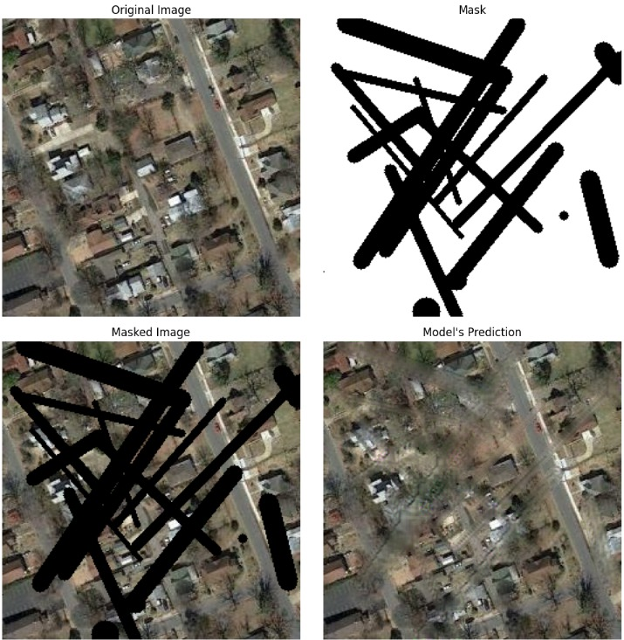
Inference

Slide 13
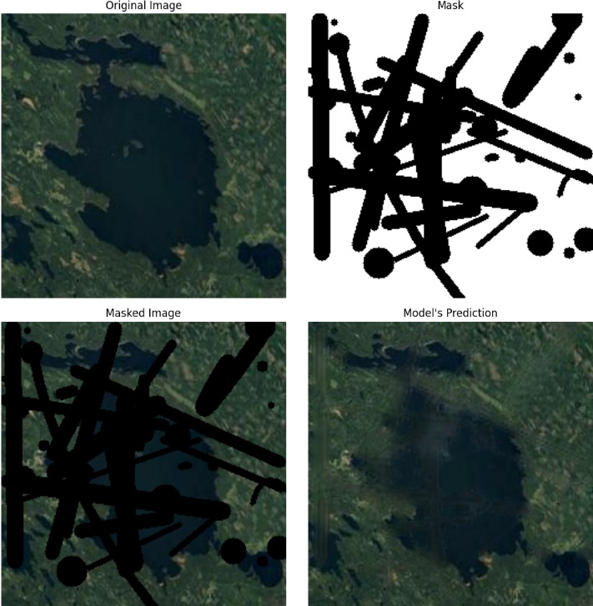
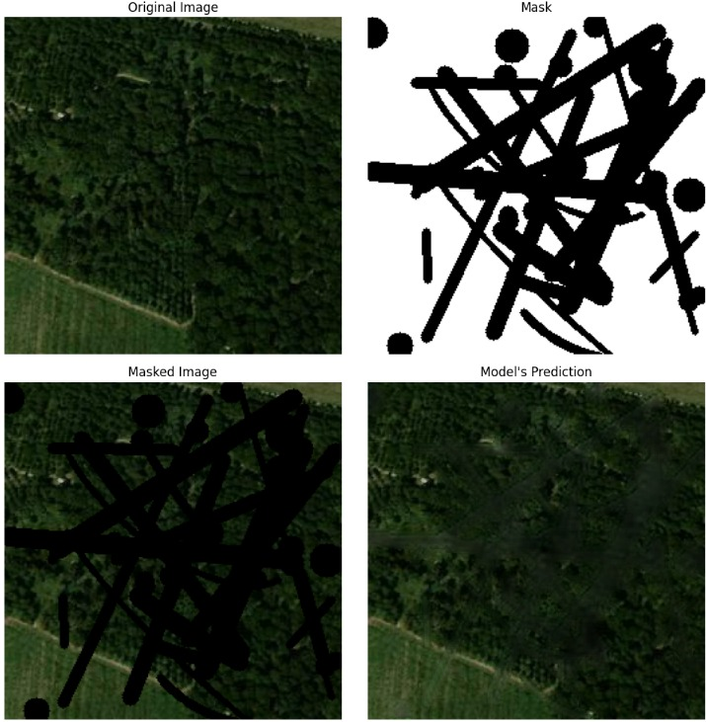
Inference

Slide 14
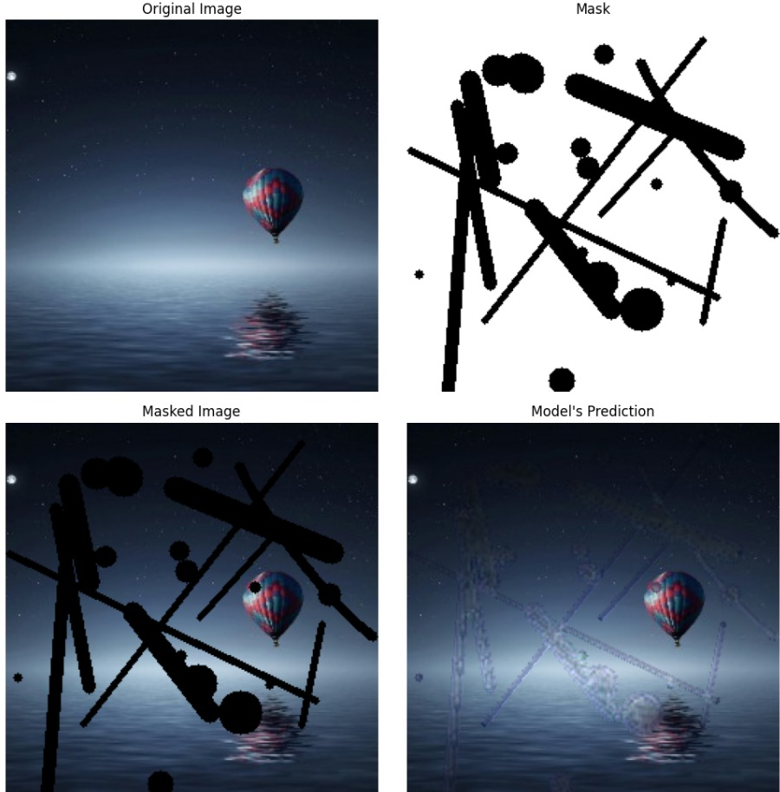
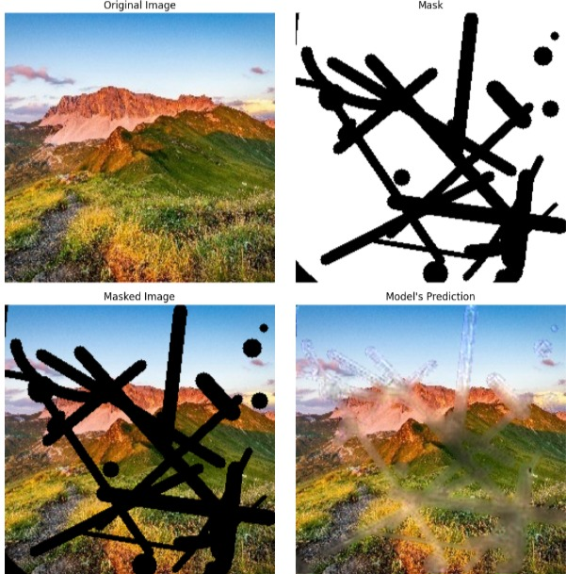
Out Of Distribution Inference

Slide 15
References
http://kaggle.com/datasets/ankit1743/skyview-an-aerial-landscape-dataset
https://github.com/tanimutomo/partialconv/tree/master
https://lilianweng.github.io/posts/2021-07-11-diffusion-models/
https://arxiv.org/abs/1803.07422
https://github.com/Shivkumar25/Image-Inpainting
https://github.com/db2003/image-inpainting
https://arxiv.org/abs/1804.07723
https://towardsdatascience.com/pushing-the-limits-of-deep-image-inpainting-using-partial-convolutions-ed5520775ab4/

